Slide 1
NEGOTIATION AND CONFLICT MANAGEMENT Distributive Negotiation

Slide 2
Distributive Negotiation
In reality, a perfect “Win-Win” negotiation is very rare
Resources need to be split among parties
Because of the long-term expectations in many business negotiations, the goal can be to “win” the negotiation, but make the other party feel as though they have won
Consider negotiation as a game of chess
If you make certain moves, you can expect the other party to make appropriate moves in response

Slide 3
Fundamental Distributive Concepts
Assess and improve your BATNA
Nothing will improve your position more than a great BATNA
Know your reservation point…but do not reveal it unless:*
A time constraint is about to force you from the table
You have a great BATNA and will be happy with any agreement in excess of your reservation point
Do not lie about your reservation point
Research and estimate the other party’s BATNA and reservation point
Be careful of misleading information
Clarify and adjust notes

Slide 4
Fundamental Distributive Concepts
Set high, but realistic, aspirations
Your first offer is an important anchor point
Try to make it at the positive edge of the bargaining zone
Focus on your target, not your reservation point
When knowledgeable, make the first offer
Set a strong anchor
Creates potential for concessions (no repeated concessions)
Preferrable to not set a range
If setting a range, know where to set it
The lower value will become the anchor
Re-anchor if you do not make the first offer
Do not accept the first offer
Stick to what you know and do not forget your target

Slide 5
Fundamental Distributive Concepts
Do not fall for an “even-split” trick (anchors and values)
…but use the trick if you can
An even-split between opposing reservation points can be even only if the issue is equally valued
An even-split between two current offers is likely not even in value to each party

Slide 6
Fundamental Distributive Concepts
Plan your concessions
Expect to make concessions
Know your issues and the relative value of each issue
Start small and do not repeat before the other party responds
Make gradual concessions
Principled offers and concessions
Provide a rational reason for your offers (and giving ground)
Doing so changes the perception from a victory for the other party or a reckless retreat, to a reasoned and calculated readjustment of position

Slide 7
Common Methods
Factual argument
Although emotional appeal may work in some circumstances, objective facts usually have more influence, especially in business
Try to provide insightful and well articulated arguments that go beyond what the other party may have considered
If you provide information the other party does not possess, they likely will need to reassess the situation and change their position
Examples: valuation data in the Blue Buggy negotiation, appraisal prices in Sugar Bowl negotiation

Slide 8

Common Methods
The use of props (e.g., brochures, documents, videos)
Provide facts to support your position or a history of similar negotiation outcomes
Props are respected because they are something people can hold that present the facts you have verbally expressed
Props remain even when the words spoken are gone
Props demonstrate you are prepared and you know what you are talking about (authority)
Silence and patience
People fear silence. The other party often will talk more and disclose information or offer concessions
Speak when you have something important to say, and then remain quiet (particularly when making an offer)
Tennis

Slide 9
Common Methods
Threats and promises
Using a threat shows the other party there will be consequences for their unwillingness to accept a mutual agreement
Threats should be appropriate in size (or they will be dismissed)
Never issue a threat unless you are willing to follow through
Consider if your threat will prompt a larger counter-threat
Will following-through cost you more in the long-term
Promises offer affirmation that you will be willing to change position simultaneously with the other party (split-the-difference)
Promises are generally more effective. People do not like to be threatened and threats often disrupt the negotiation process
The framing of arguments is critical to success

Slide 10
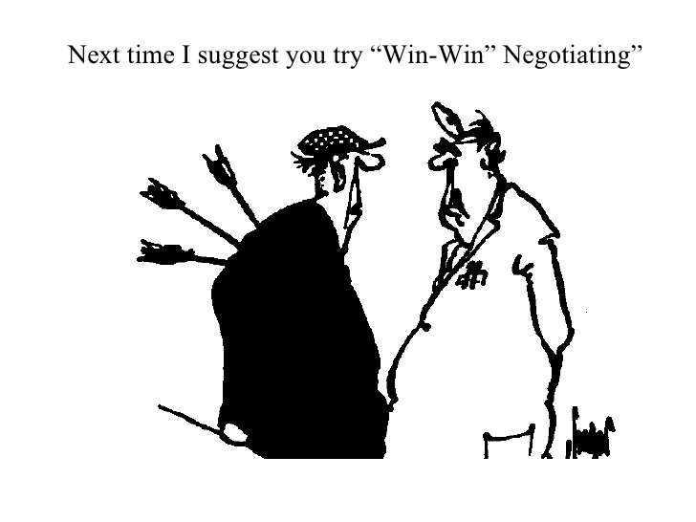
Common Methods
Limited authority
Allows you an ‘out’ to regroup if necessary
Creates a psychological commitment from the other party and allows you to renegotiate terms based on the higher authority’s demands
If the other party has limited authority, so do you
Never trade information with someone who has no authority (different from limited authority)

Slide 11
Other (not so recommended) Methods
Boulwareism
Take-it-or-leave-it offers
Risky, as people are often offended by this type of tactic
Do not instantly reject. The offer may actually be in your favor
Faked anger
Be careful, faking anger may offend the other party
Reacting to anger
Reciprocal
Offended
Listen carefully if the other party is truly angry, they may disclose important information

Slide 12
Other (not so recommended) Methods
Uproar
The use of shocking/extreme threats/outcomes (e.g., laying off half of a workforce if employees do not accept a pay cut)
Two questions when faced with this
What is the likelihood of the consequences?
What happens to the other party if the consequences occur?
Determine if you can call their bluff
Reverse psychology
Good to use if the other party is purely out to make you lose
You may be able to trick a novice negotiator to give you what you want
Be careful, as you may end up getting what you don’t want

Slide 13
Controlling the Interaction
It may seem counterintuitive, but the less you know the other party, the more you should ask for in an initial offer (reasonably close to the ZOPA)
They may give you more than you expect
You can build a relationship by offering concessions from your aggressive initial offer
Very common in some cultures (e.g., parts of the Middle East)
As you make small concessions, the other party feels as though it is winning, even though you are still near your target

Slide 14
Controlling the Interaction
Never say yes to the first offer
The other party will think:
“I could have done better”
“Something must be wrong”
The price paid can be less important than thinking they won
You can almost always do better than the initial offer
“Flinch”
Act with surprise at the other party’s offers
People often respond to visual cues more than audible cues
A flinch may show the other party they have gone too far, even if they haven’t, and they may instantly make a concession

Slide 15
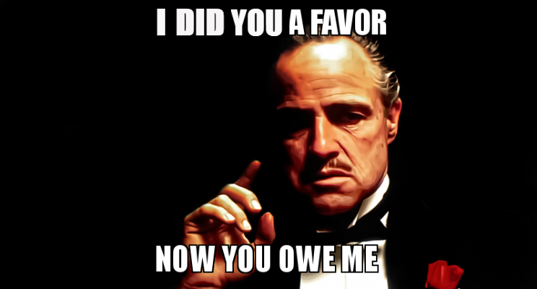
Controlling the Interaction
Use the “reluctant participator” technique
Feign walking away or never beginning the negotiation
Say something similar to “I probably shouldn’t negotiate this, but I really like you. What is the lowest/ highest price you can do? I can take it to my boss and tell him/her why we can work together.”

Slide 16
Controlling the Interaction
Vise
Say “You’ll have to do better than that.”
Then shut-up and await their response
The other party then needs to make an instant concession to continue
Works much better when you have the superior BATNA
If you are faced with that statement respond “How much better do I have to do?”
It forces the other party provide a price point while you reevaluate your options

Slide 17
Controlling the Interaction
Set difficult individual issues aside
If there is a disagreement on an issue that isn’t moving forward, set it aside and work on other issues
Build momentum on easy issues and then return to the difficult one with the hope that the positive agreements will influence the difficult issue
Beware the nibbler
When you have seemingly made an agreement the other party may try to “nibble” away at the agreement
Do not let the other party get free concessions because you are ready to seal the deal
Remain focused through the completion of the negotiation

Slide 18

Controlling the Interaction
Be a tugboat
Use time to help you breakdown the other party
People often get antsy and want to come to an agreement
Tugboat – slowly move them to your perspective
Don’t forget your most powerful weapon
The ability to walk away and use your BATNA
The second you lose the ability to walk away, you lose the negotiation
Do not forget your BATNA

Slide 19
Summary
There are numerous strategies that can be used to improve distributive results in a negotiation
Effectiveness depends on context and level of comfort employing the strategy
Always remember to “increase the pie” with integrative strategies
Gain more of an overall increased “pie” with distributive strategies

